Slide 1

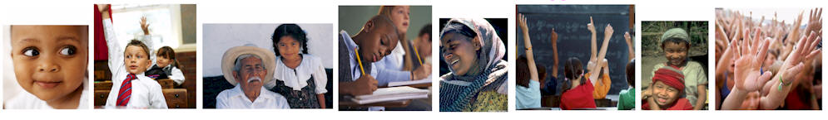


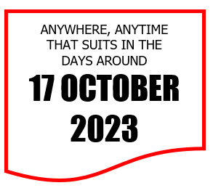

Guide to the 2023 slideshows
for school staff and others

Slide 2

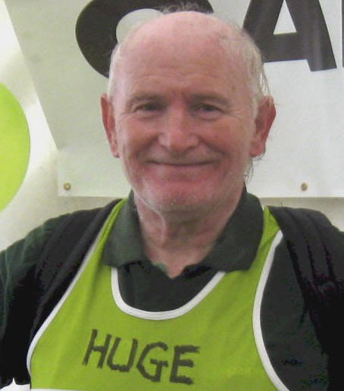



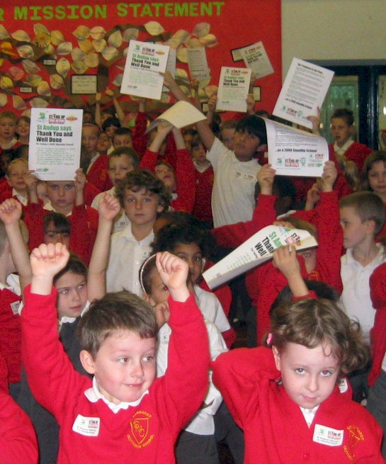
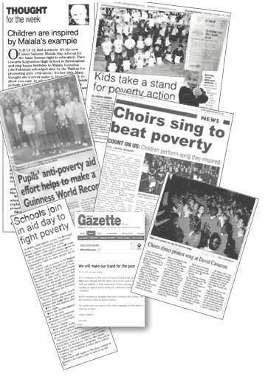
BRIEF BRIEFING 1
by Hugh Gibbons, Conductor of Just1
(which is just me)
Welcome to the slideshow versions of the Just1 Promises on Poverty and the Count On Us Song – a sort of late, late encore.
You should find them good for classroom or assembly, or on screens large and small – ideally, anytime during the week that includes 17 October, the UN Day for the Eradication of Poverty.
As before you’re welcome to change anything to suit your setting – whether words, tune, pictures.
The origin? In 2008-10 I suggested some simple promises based on the then Millennium Development Goals. These let UK schools and others join many millions of people in the actions of the Global Call to Action Against Poverty (setting a Guinness World Record, btw). In 2011, many hundreds of pupils added the Count On Us Song which had been loitering in my head.
Like me, both Promises and Song have been updated, as you’ll see on the next slide.

Slide 3
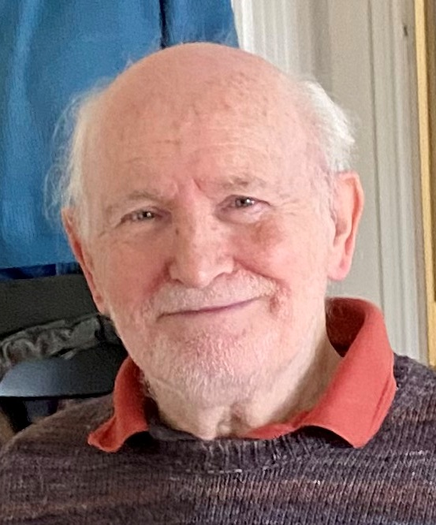
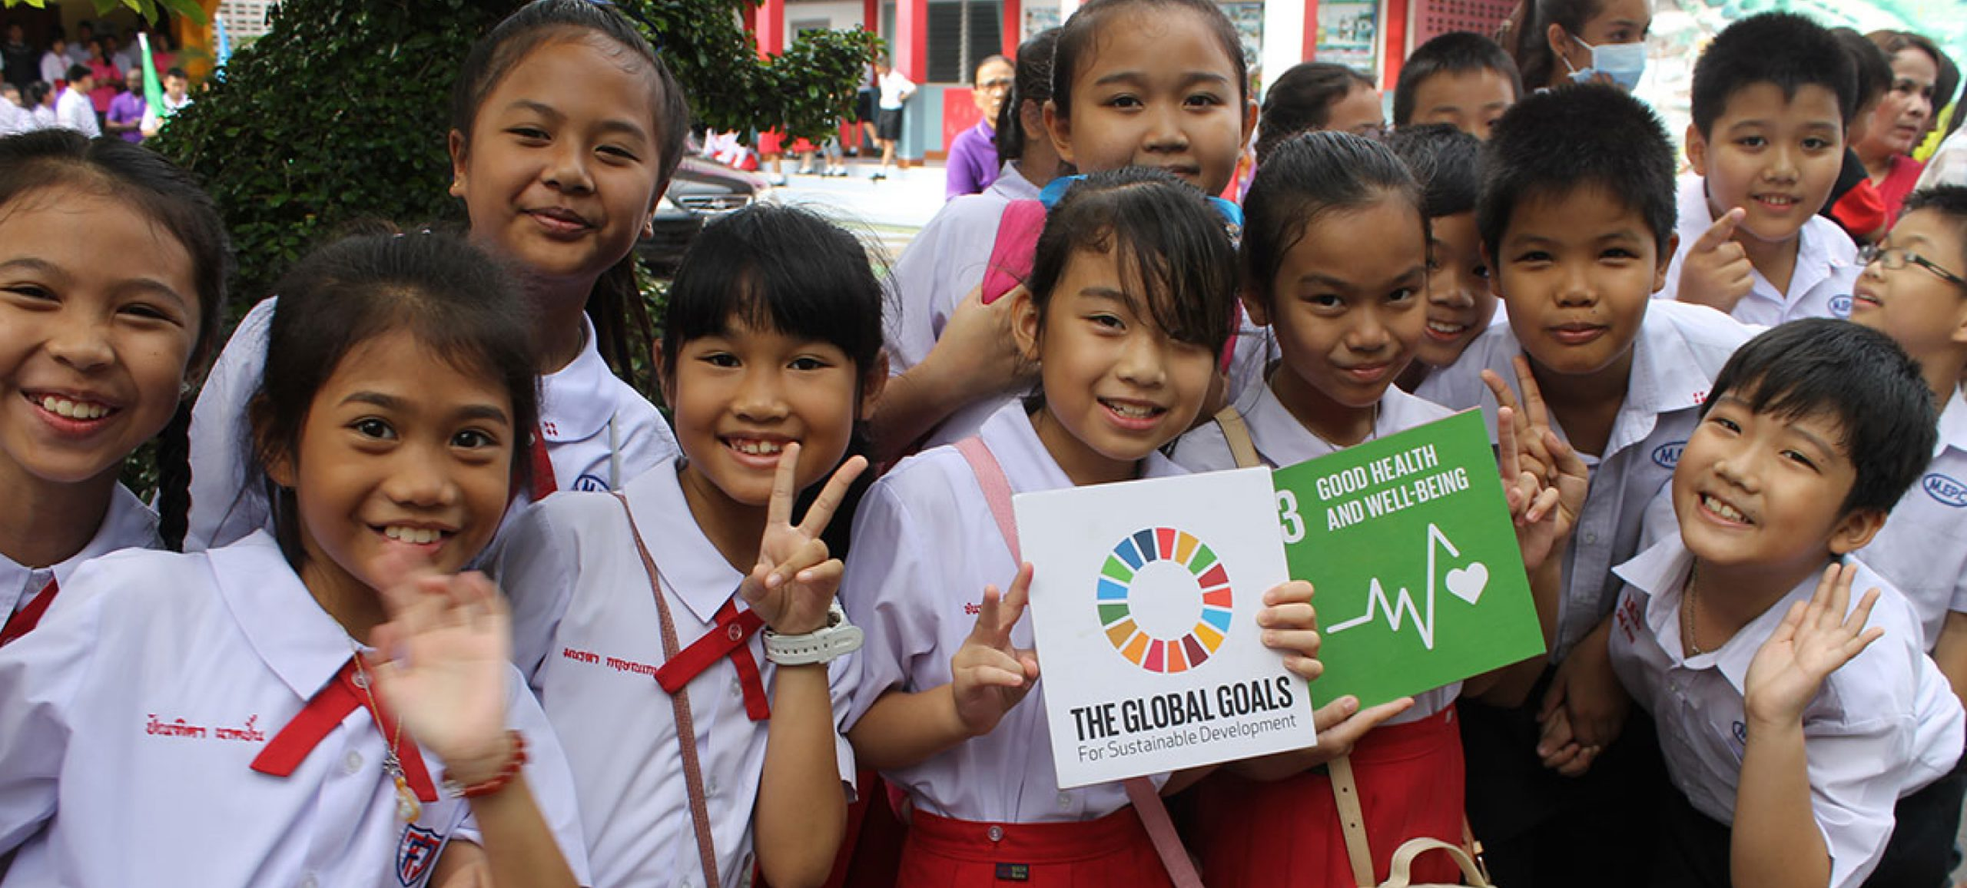


BRIEF BRIEFING 2
The Promises on Poverty now reference the UN’s Sustainable Development Goals.
These are a collection of 17 interlinked global goals designed to be a blueprint to achieve a better and more sustainable future for all. The SDGs were set up in 2015 by the United Nations General Assembly and are intended to be achieved by 2030. They’re shown larger on the next slide.
The Promises start with No Poverty, Zero Hunger, Good Health & Wellbeing, and Quality Education. Clean Water and Sanitation, Climate Action, Peace & Justice, and Decent Work also get mentioned. And there’s much appreciation of all those who take action on the SDGs and otherwise in working for a better world.
Each of the Promises starts with pictures found online. The Count on Us Song has some from the People’s Assemblies organised by the Call to Action Against Poverty in September 2021.

Slide 4


Slide 5
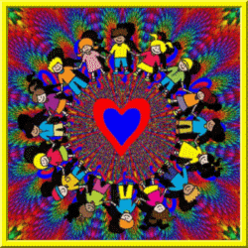

Slide 7


Slide 8


Each year, 17th October is a special day marked by millions of people around the world.
It's the United Nations Day for the Eradication of Poverty.
Eradication means ending the many forms of poverty that millions and millions of people
suffer day after day.
So what we're going to do is spend a few minutes thinking about them – and the sort of world we want to see for them (and us) as we grow.

Slide 9
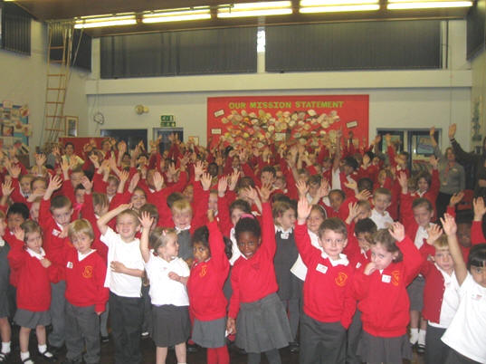

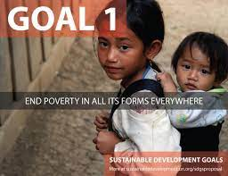
We're not alone in this.
Many schools and others are joining in this week’s show of action to help end poverty.
We’re also appreciating the year-round work of many organisation and individuals campaigning all the year round against poverty - and for all of the Sustainable Development Goals.
Ready to make some Promises?

Slide 10
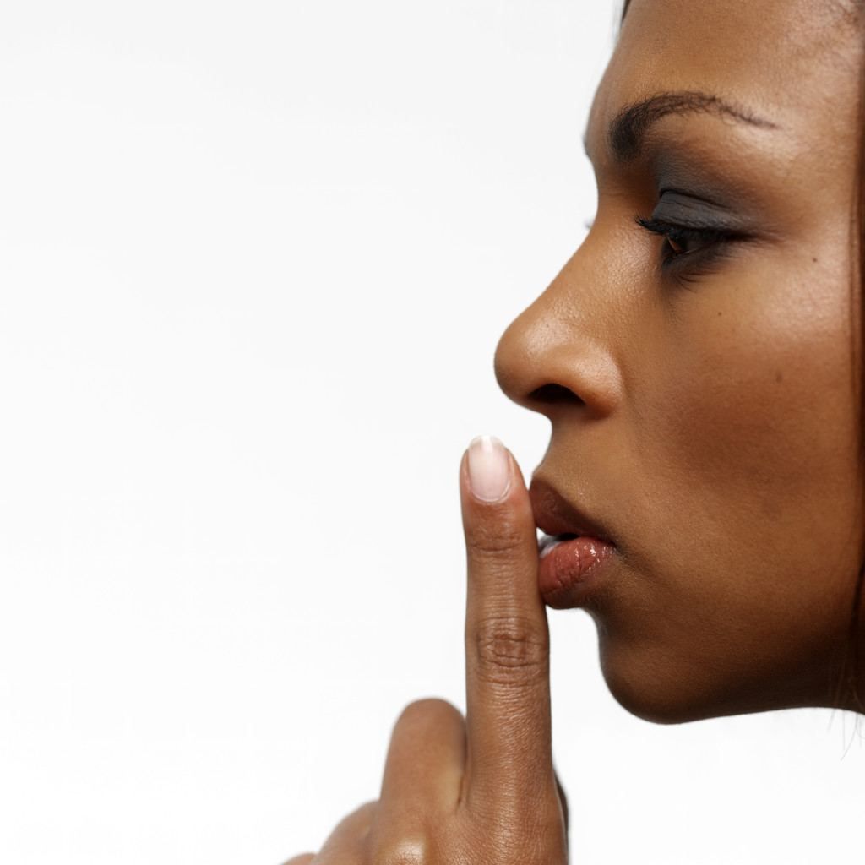
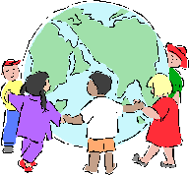
Let’s start
by listening
for the voices of those suffering poverty around the world
coming to us from the
East, West,
South and North.
Now let’s tell them why they can count on us to be of help.

Slide 11
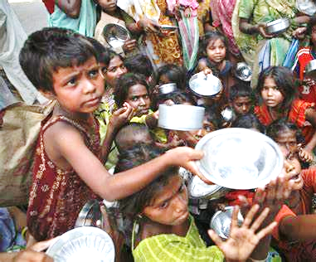
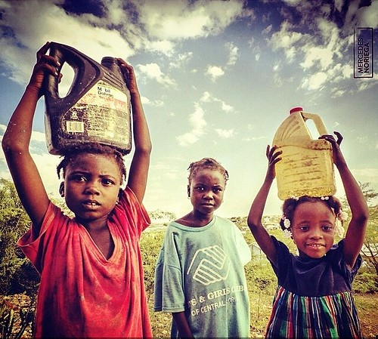
We want a world that wants to end Food & Water Poverty
Unlike us, millions of people go hungry all day and every day.
And millions of families also suffer without clean water to cook or wash, or for toilets.
So shall we promise to stand up for them – and do what we to make sure there’s zero hunger and clean water for everyone?
Shall we? YES!

Slide 12
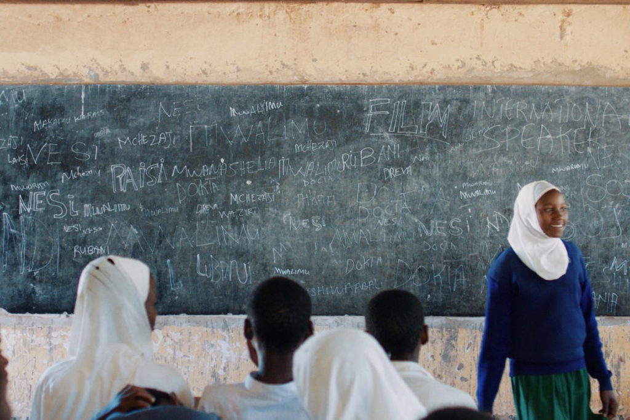
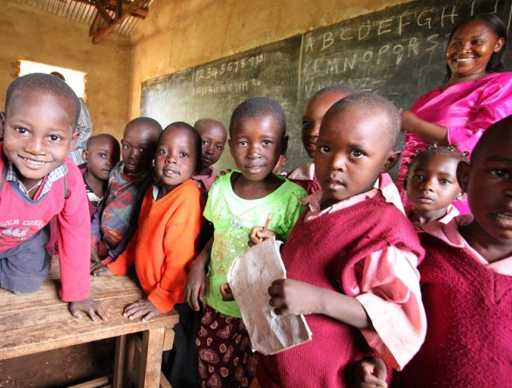
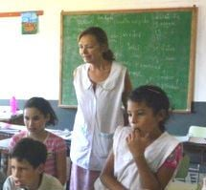
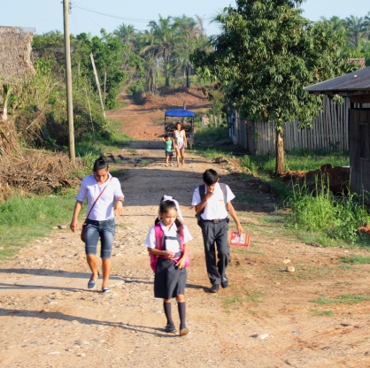
We want a world that wants to end Education Poverty
Unlike us, millions don’t get even basic schooling – or don’t progress to higher levels. Many don’t have enough teachers, or equipment, or space to study properly.
So shall we promise to help make sure that the world has quality education for everyone – everywhere?
Shall we? YES!
We want a world
that looks after babies and mothers
Each day 30,000 children and many mothers in childbirth die due because of poverty – unlike here.
So today shall we count our blessings – and promise to stand up for reducing child mortality?
Shall we? YES!

Slide 13
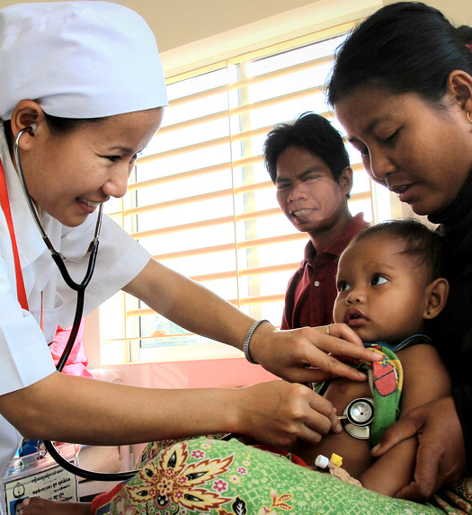
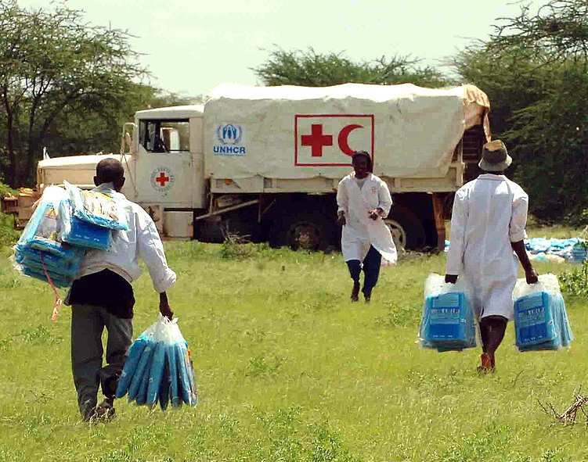
We want a world that wants to end Health Poverty.
Unlike us, millions don’t have the medicines, vaccines, doctors, nurses, hospitals, services, social care or education they and their families need to be and stay well.
So shall we promise to help make sure there’s good health and wellbeing for everybody, everywhere?
Shall we? YES!
We want a world
that looks after babies and mothers
Each day 30,000 children and many mothers in childbirth die due because of poverty – unlike here.
So today shall we count our blessings – and promise to stand up for reducing child mortality?
Shall we? YES!

Slide 14
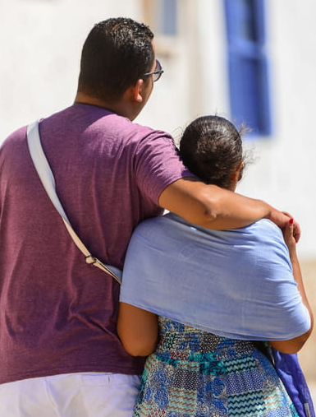
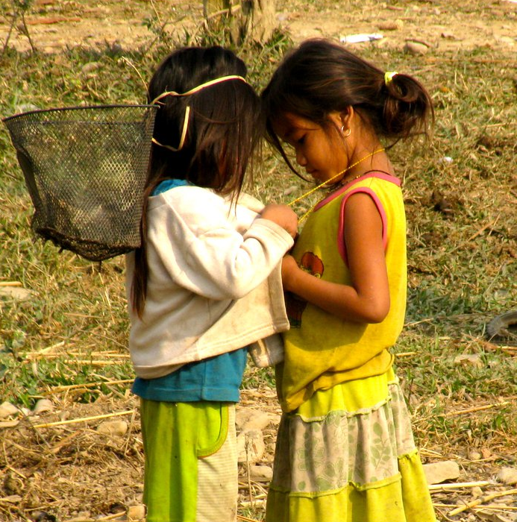
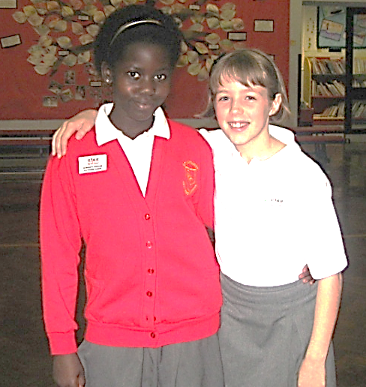
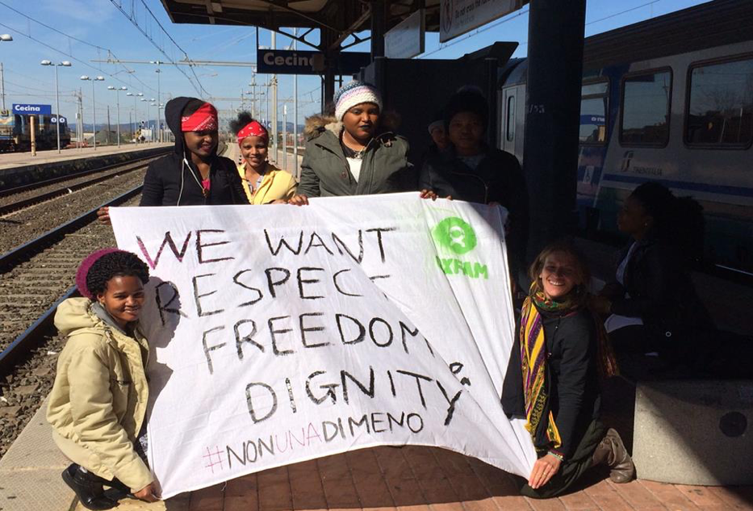
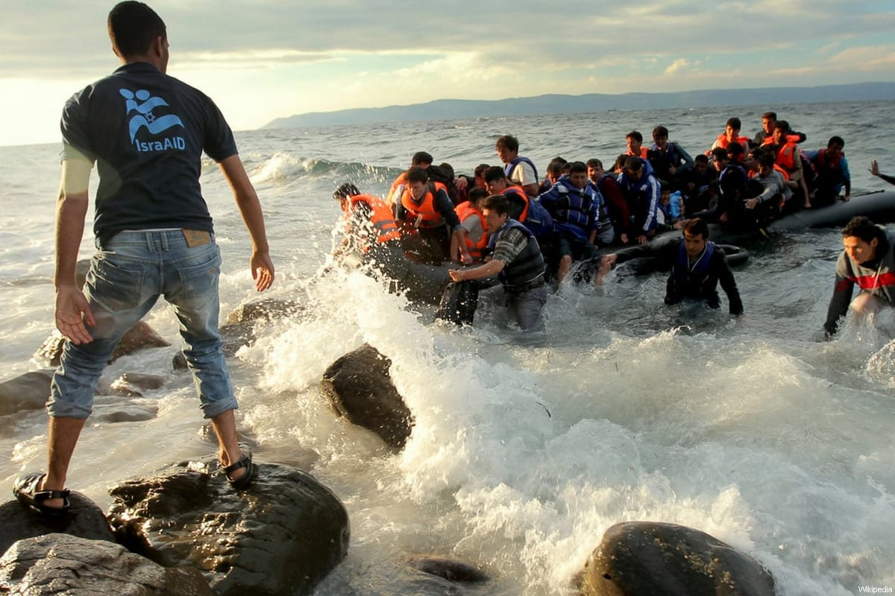
We want a world that wants to end Fairness Poverty
Millions of people suffer inequality every day.
Yet everyone needs treating with dignity, respect, justice and fairness to have decent working and personal lives.
So shall we promise to do what we can to encourage peace, justice, dignity, human rights, and equality – for everyone?
Shall we? YES!
We want a world
that supports fairness, justice, dignity
and respect
In all countries, people need these to have proper lives. So today shall we count our blessings and promise to speak out for
all those working for peace and justice, human rights, and equality?
Shall we? YES!

Slide 15
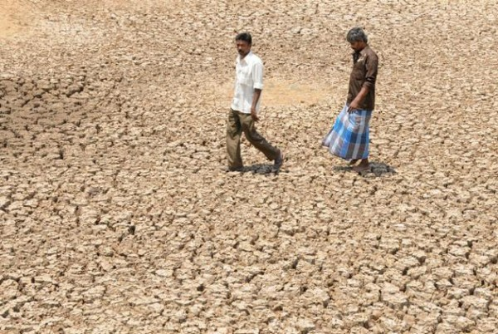
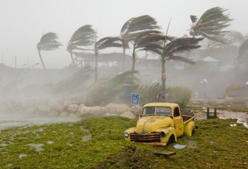
We want a world that wants to end Earth Resources Poverty.
Millions are already suffering the effects of climate change and avoidable environmental damage – whether on land or under the sea.
So shall we promise to help ensure that the many riches of our planet are cared for, renewed, and shared fairly – by everyone
Shall we? YES!
We want a world
where all children get
a basic education
Unlike us, many millions do not start or finish school.
So today shall we count our blessings - and promise to stand up for making sure that all children get
basic schooling?
Shall we? YES!

Slide 16
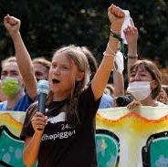
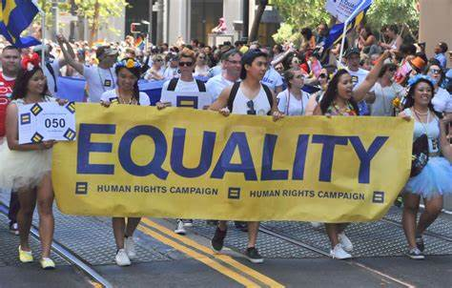
We want a world that wants to end Indifference Poverty
Millions of people suffer because not enough individuals - or governments - care what’s happening.
So shall we promise to be among the many millions who are concerned, and who do take action, and really want to see an end to poverty in every form, and everywhere?
Shall we? YES!
We want a world
that respects the world’s resources
Millions of people are already suffering the effects of climate change and environmental damage.
So shall we count our blessings today - and promise to stand up and speak out for those working hard to ensure that the riches and benefits of our planet are shared fairly, and by all?
Shall we? YES!

Slide 17
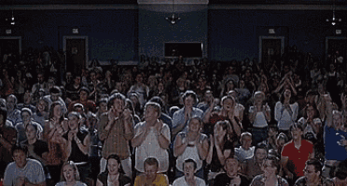
Very many thanks
Now shall we applaud each other and say Well Done for Standing Up Against Poverty & Inequality today?
And every day?
YES!

Slide 20


Slide 21

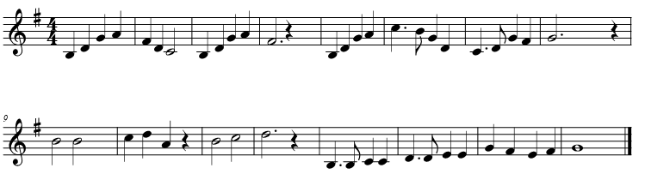

The Song is meant to be simple and uplifting – whatever the key, tempo, type of voices or instruments taking part. If you can’t sing, just say the words or hum along. Or make up your own tune.
NB Each verse now has words that might suggest actions for hands, arms, eyes, legs, heads,
and hearts!

Slide 22
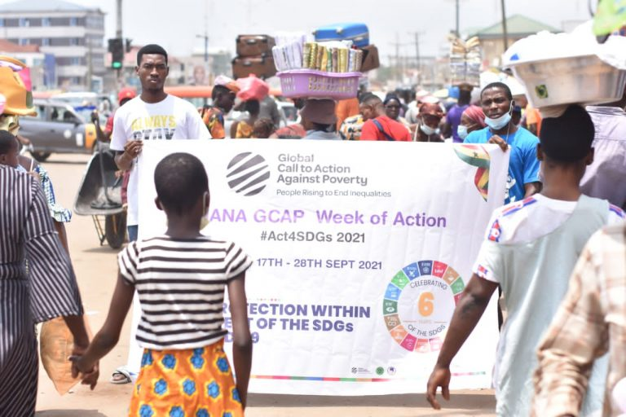
The pictures for each verse were taken at National People’s Assemblies in 28 countries in September 2021 – a week of action co-ordinated by the Global Call to Action Against Poverty. One outcome was the Covid-19 Wake Up Call – We The People Resist Being Left Behind.

Slide 23
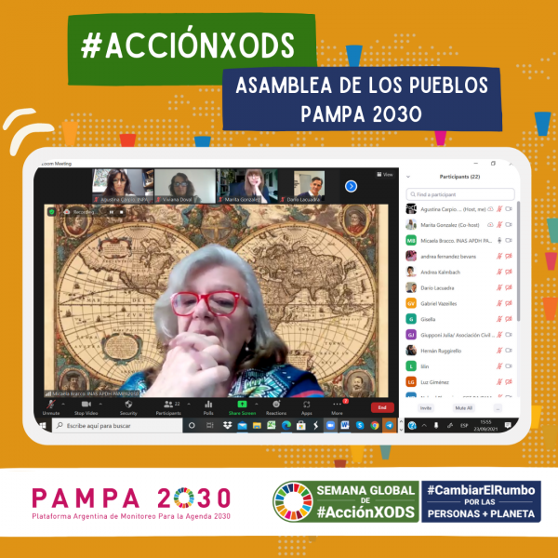
.
To begin, let’s have a moment of quiet
listening for the voices of those suffering poverty and inequality
coming from the south, east, north and west

Slide 24
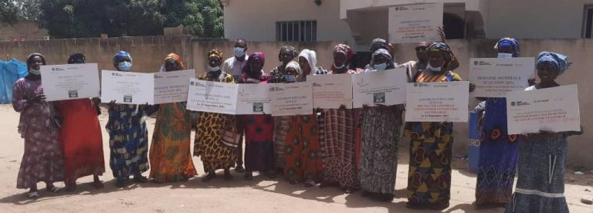
Verse 1

Slide 25
Verse 1
Poverty we want to end, and injustice too.
So we promise this together
We’ll stand up for you.
You can count on us! We’re with you!
Hand in hand and side by side, yes,
We’ll stand up for you.

Slide 26
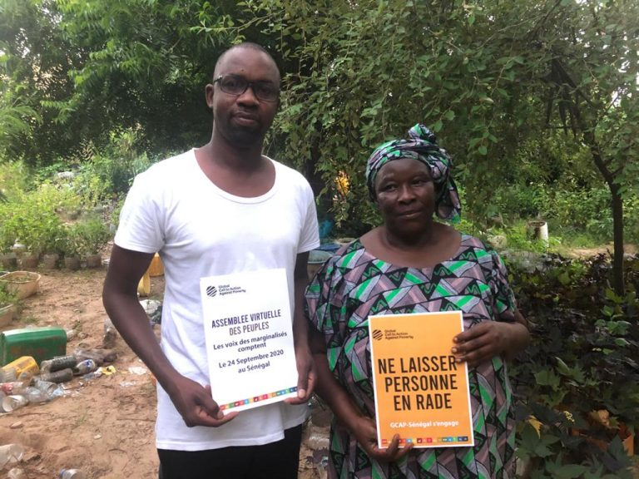
Verse 2

Slide 27
Verse 2
Hands on hearts and minds switched on
Using our eyes too
With our hands held up so you know
We’ll reach out for you.
You can count on us!
We’re with you.
North and south and east and west, Yes!
We’ll reach out for you.

Slide 28
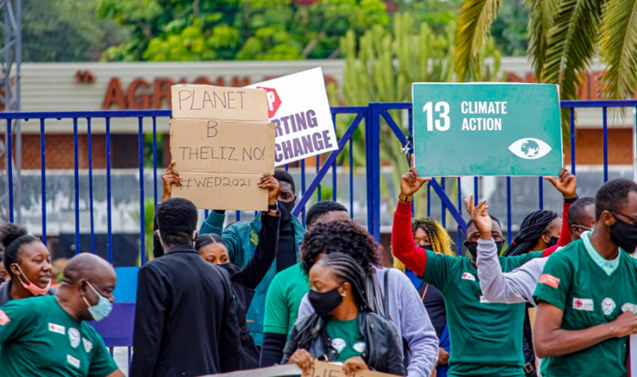
Verse 3

Slide 29
Verse 3
Ones and tens and hundreds, thousands!
(We’re not just a few)
Count on us to raise a fuss as
We speak out for you.
You can count on us!
Yes us too.
Here’s a vow we’re making now: yes,
We’ll speak out for you.

Slide 30
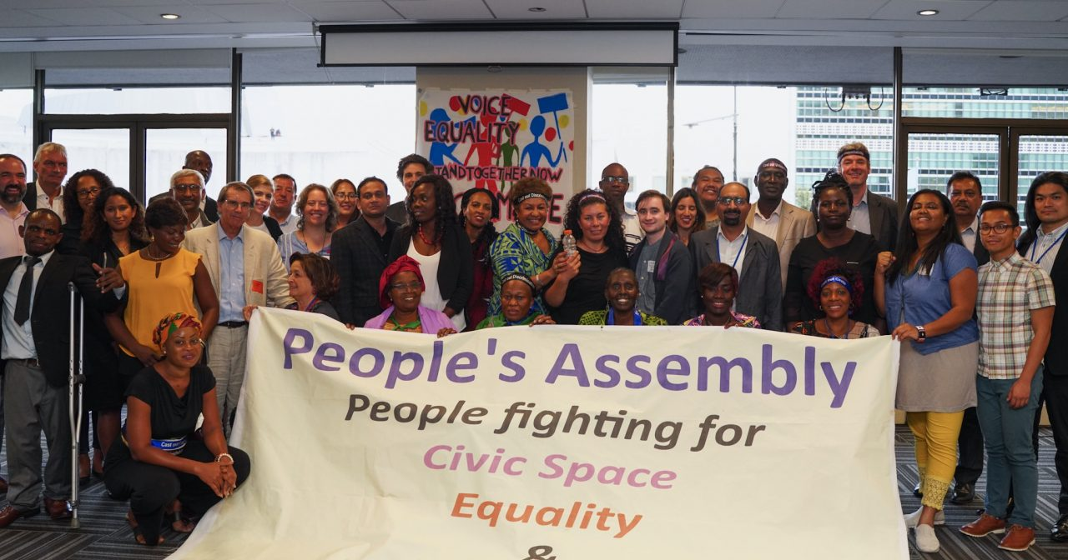
Verse 4

Slide 31
Verse 4
Poverty we want to end, and injustice too.
So we promise this together
We’ll step up for you.
You can count on us! We’re with you!
Hand in hand and side by side, yes,
We’ll step up for you.
WE WILL!

Slide 32
Let’s finish with a moment’s silence again
listening for echoes from around the world

Slide 33
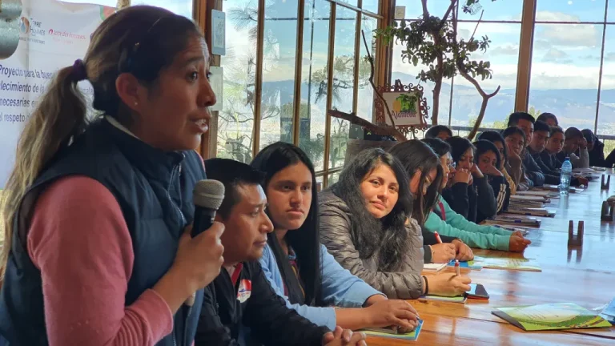
Well done!
Now sing yourself a pat on the back.

Slide 34
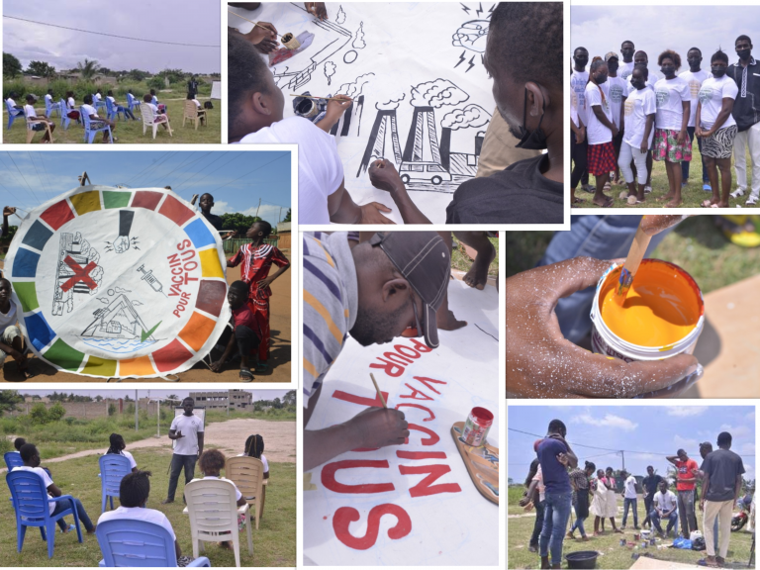
Have a good day!

Slide 35

Guide to the 2023 slideshows
for school staff and others

