Slide 1


Slide 2
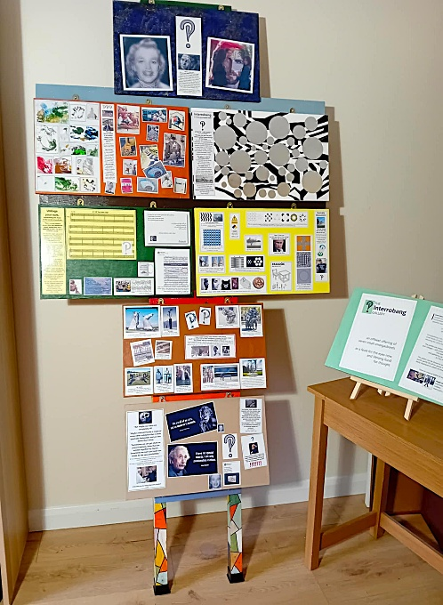
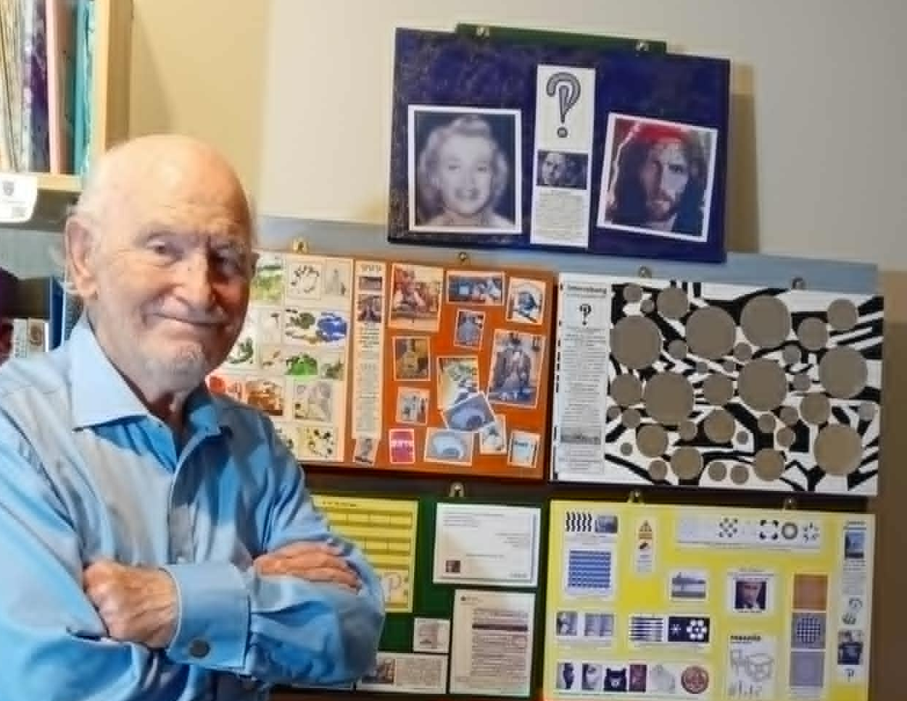
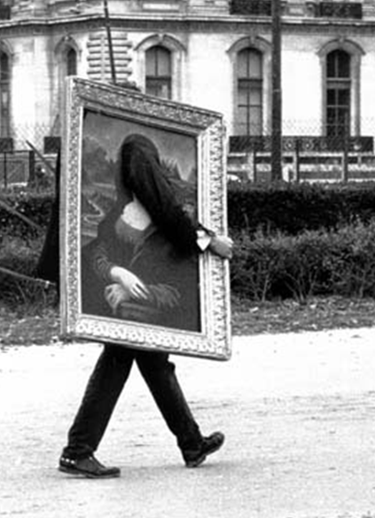

A slideshow variant assembled by Hugh Gibbons

Slide 3
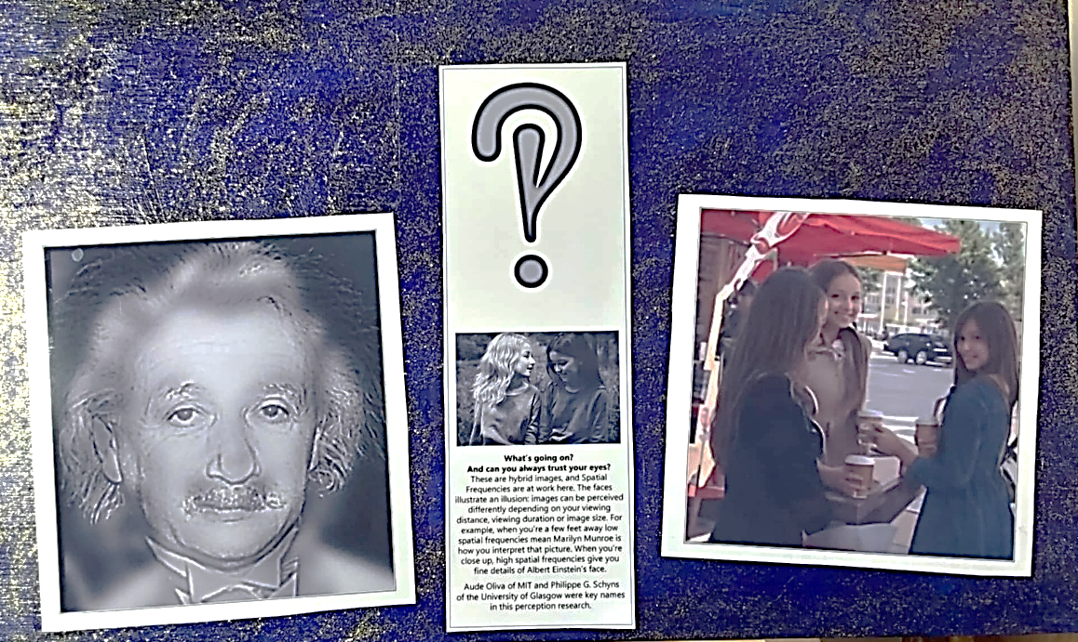
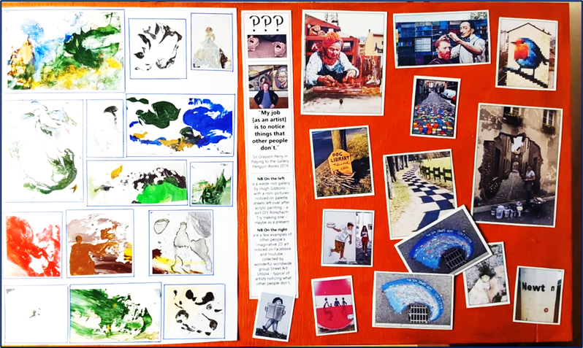
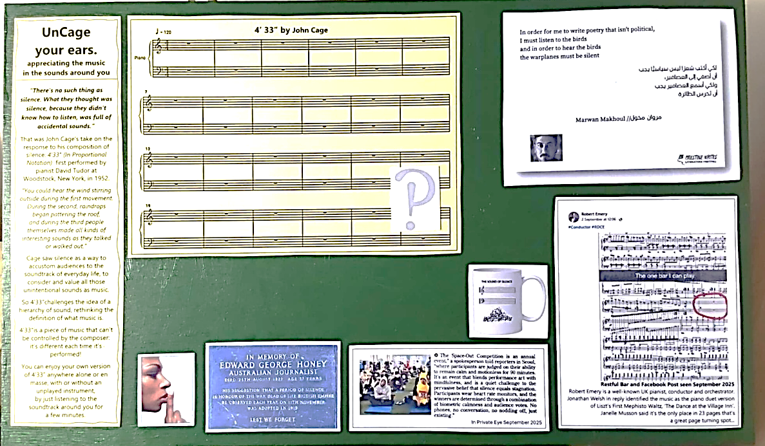
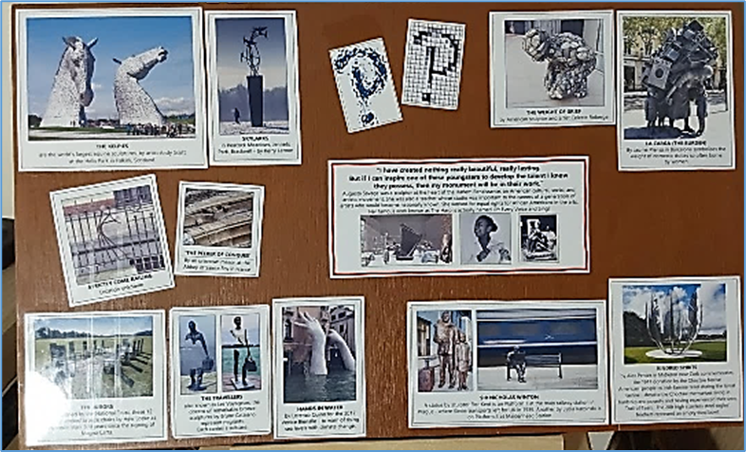
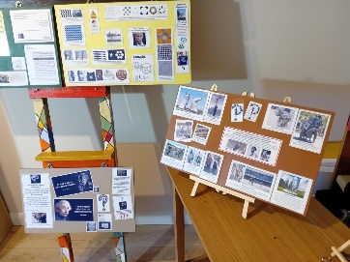
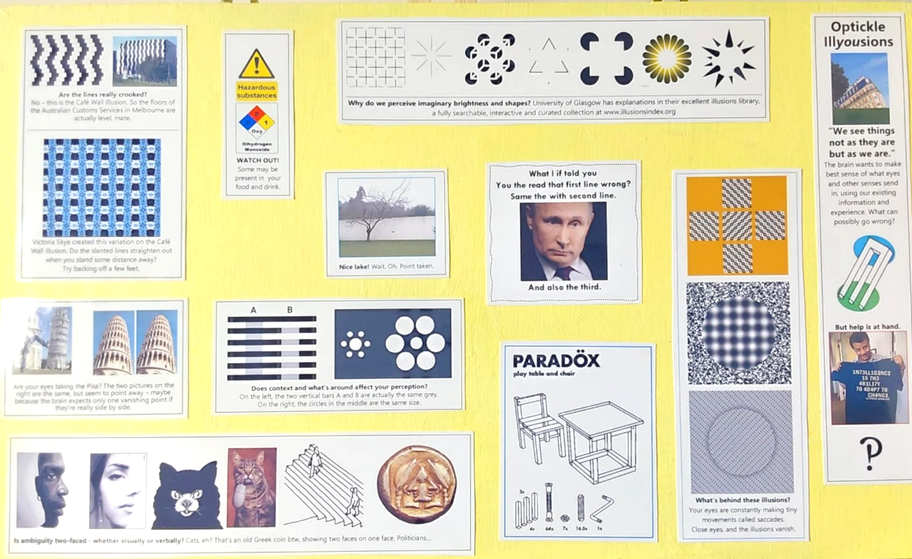
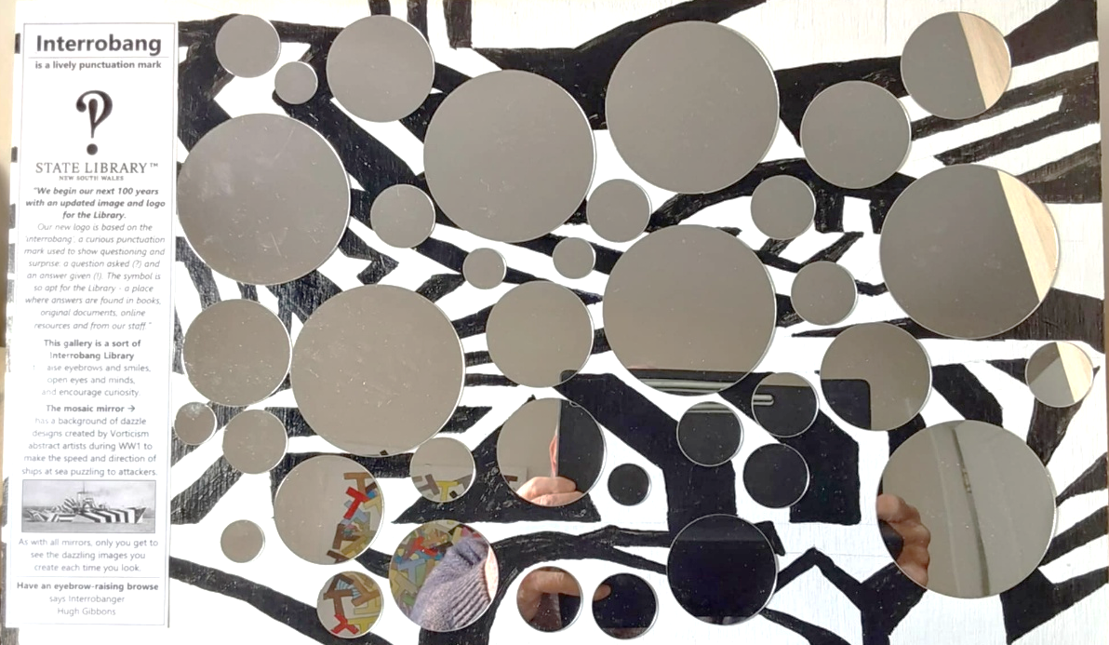
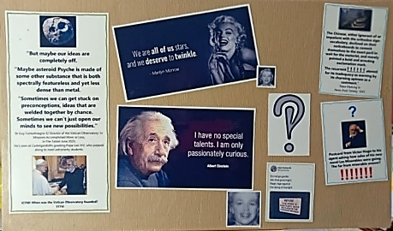
an offbeat offering of
seven small smorgasbords
as a feast for the eyes now,
and lifelong food
for thought

Slide 4
WELCOME This mainly self-explanatory slideshow has all the pictures on the seven 500mm x 300mm panels, plus a few extra, and some commentary.
Sections may be useful as an unusual classroom resource for Years 5/6 in primaries, as well as in secondaries and colleges. And you might want to consider your own gallery using some pictures.
Each panel sections starts with a solid blue slide. If you don’t want to show all the slides on a panel, Hide in the slide Sorter view is handy.
Have fun with its sleeves rolled up!
Hugh Gibbons
Head Banger!
PS This is Ug Head Interrogator helping you ask: what’s going on?

Slide 5

?
!

Slide 6
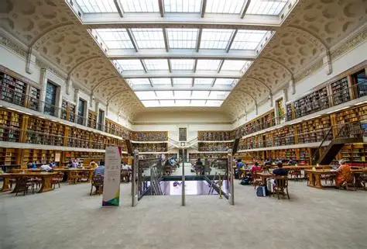
“We begin our next 100 years with an updated image and logo for the Library. Our new logo is based on the ‘interrobang’, a curious punctuation mark used to show questioning and surprise: a question asked (?) and an answer given (!). The symbol is so apt for the Library - a place where answers are found in books, original documents, online resources and from our staff.”

Slide 8
CHANGING IMAGES
PANEL
Exploring what you perceive at a distance may be different when you get up close…

Slide 9
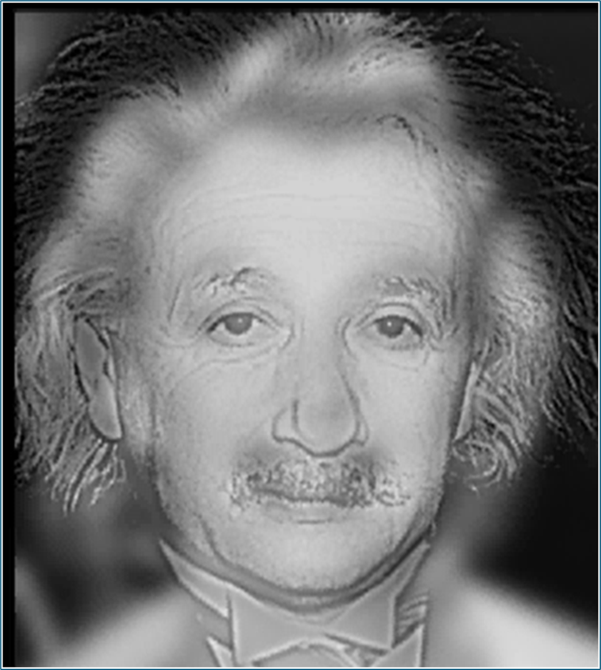
What’s going on? Spatial frequencies are at work with this hybrid image. They illustrate an illusion when images are perceived differently depending on your viewing distance, viewing duration or image size. When you’re several feet away low spatial frequencies mean Marilyn Munroe is how you interpret that picture. When you’re close up, high spatial frequencies give you fine details of Albert Einstein’s face.
Lesson: look closely before you judge what’s going on!

Slide 10
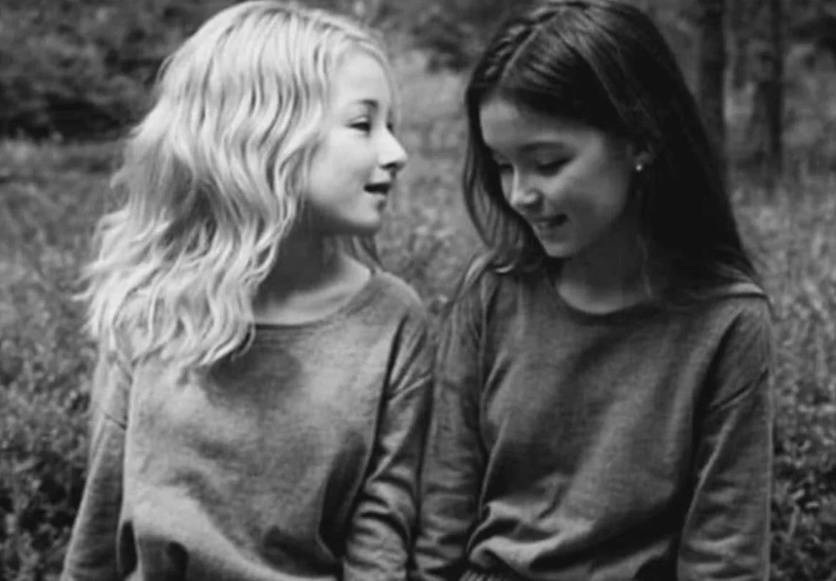

Slide 11
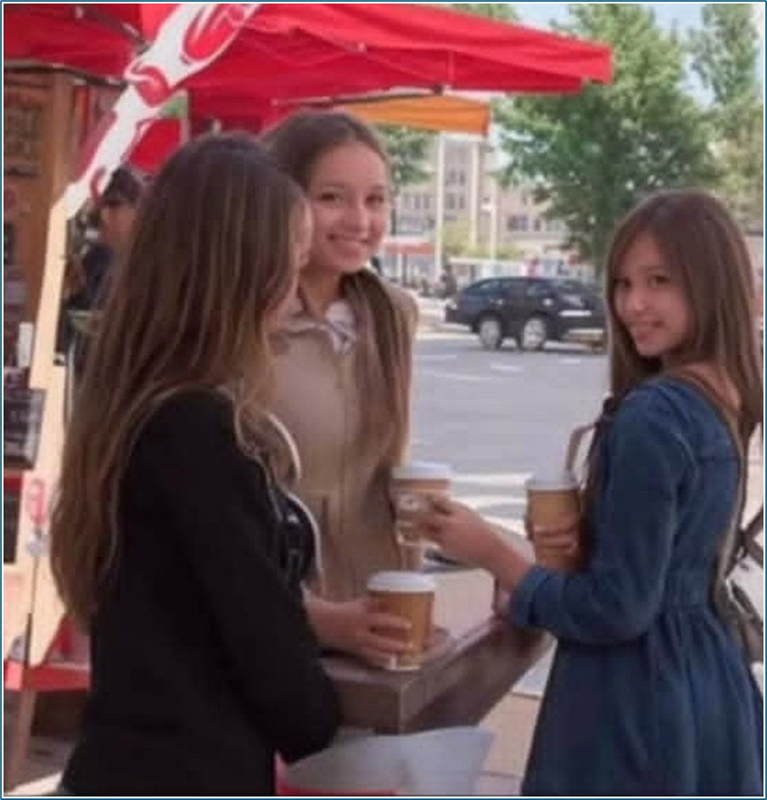

Slide 12
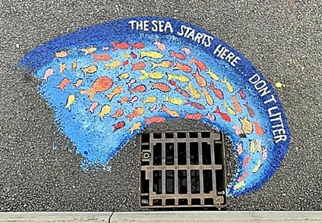

Slide 13
NOTICING THINGS PANEL
Exploring some outdoor art -
some small and spontaneous, some large and painstaking - by artists noticing opportunities to share ideas

Slide 14
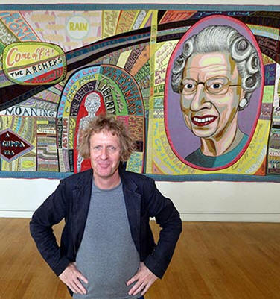
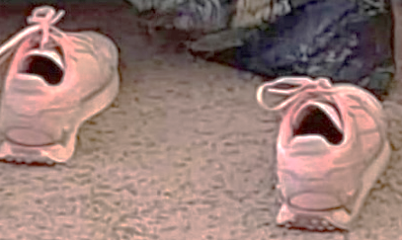
“My job [as an artist] is to notice things that other people don’t.”
Sir Grayson Perry
in Playing to the Gallery
Penguin Books 2016

Slide 15
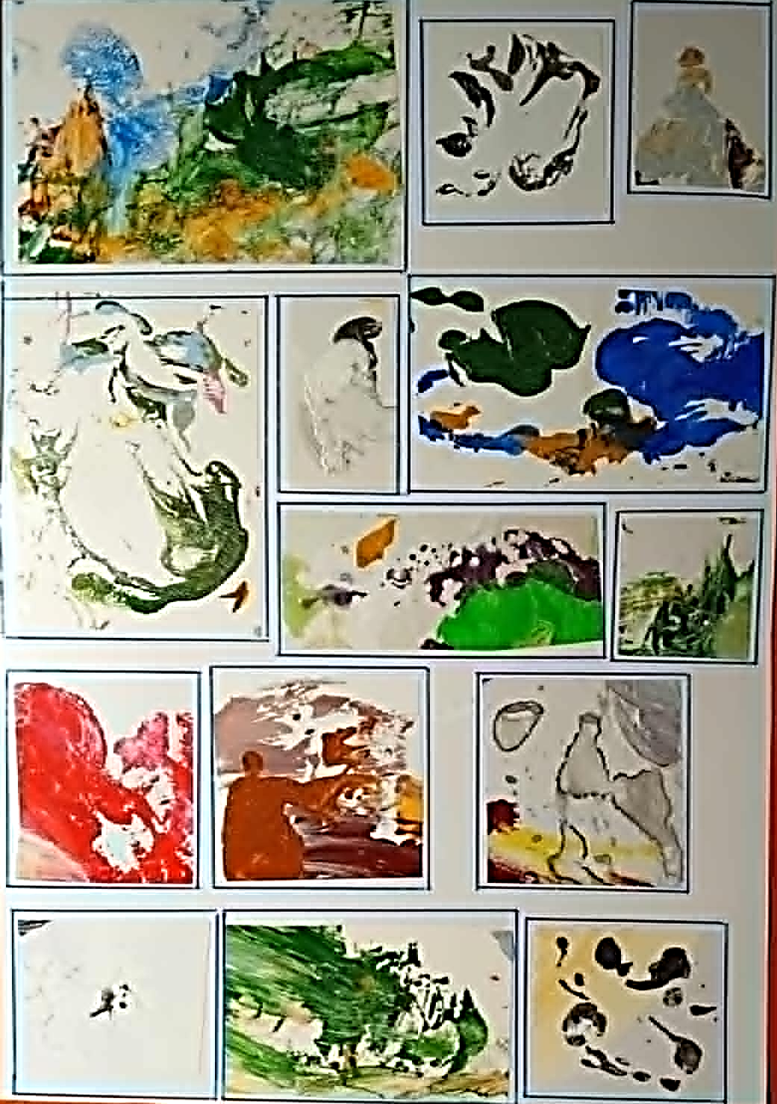
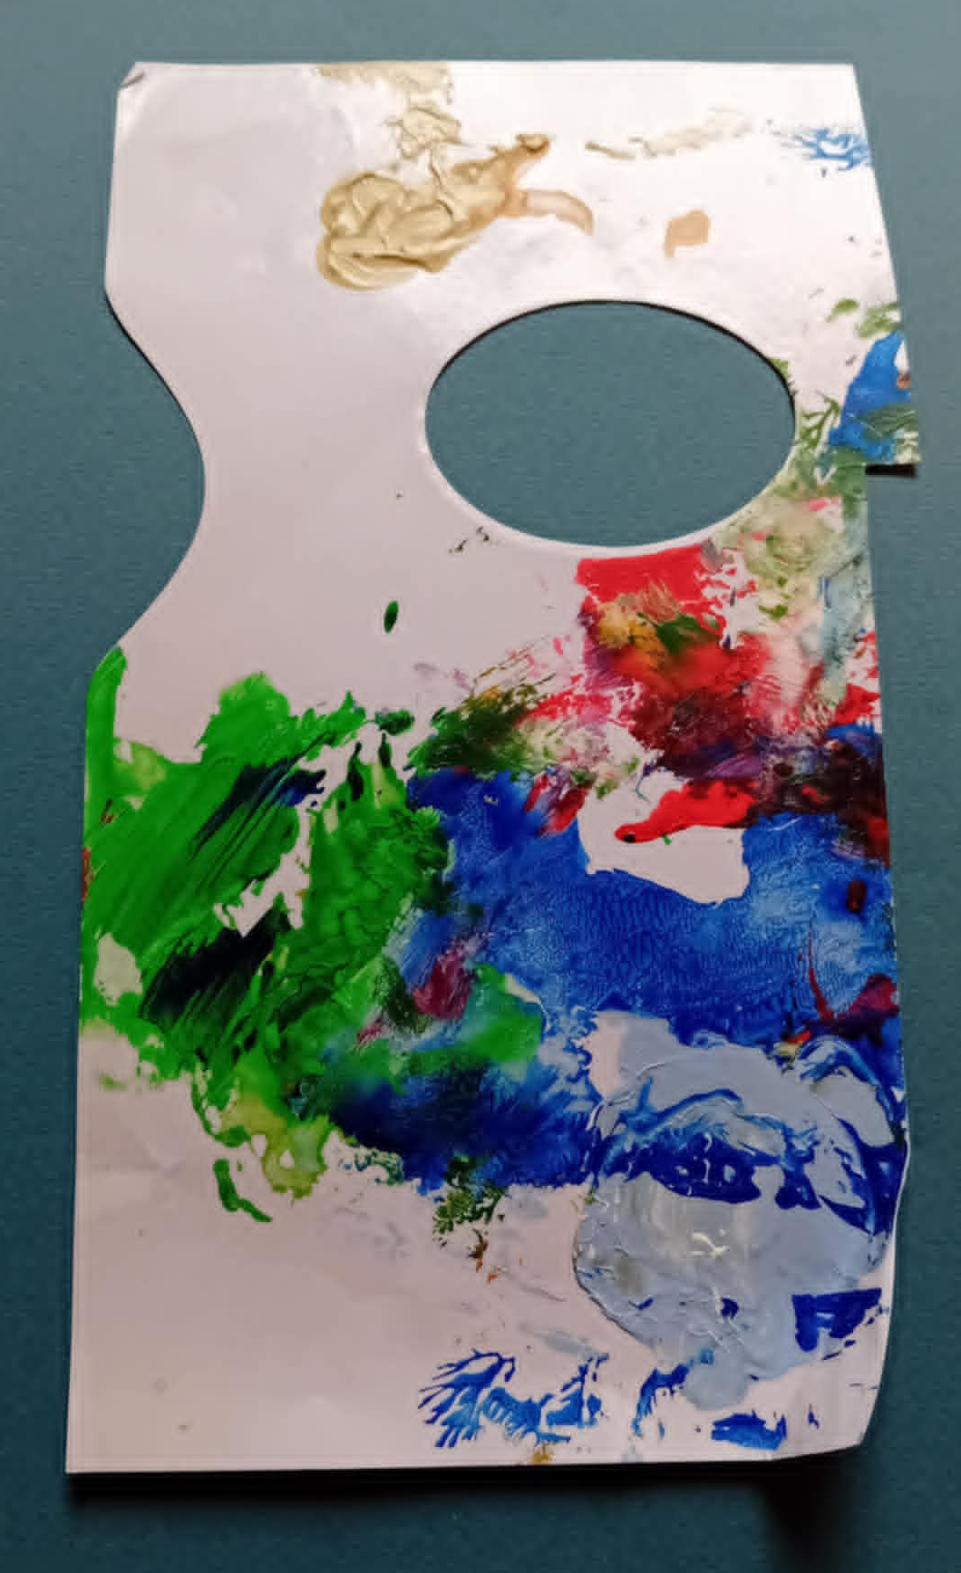
Mini A4 Gallery
made from acrylic paints left over on a paper palette after art sessions.
Don’t throw it away. Just put a plain piece of paper on top, wriggle it around, and lift off.
Then see if you can find little pictures on the page and palette that you can cut and display.
Try turning your gallery to see new mini-pictures emerge.
Laminated, these make lovely presents, btw.

Slide 16
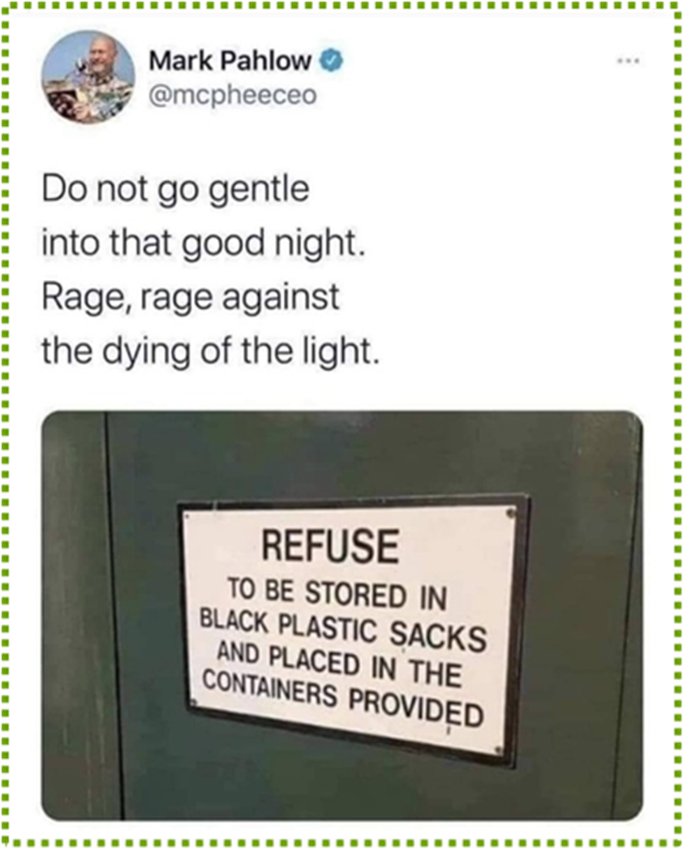
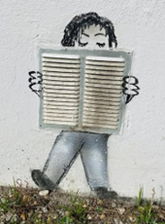
Two of the many imaginative examples of art found on the wonderful website
www.streetartutopia.com
They might be instant or deeply painstaking, often very witty, noticing opportunities big and small, and always offering food for thought.
Some follow on the next few slides.

Slide 17
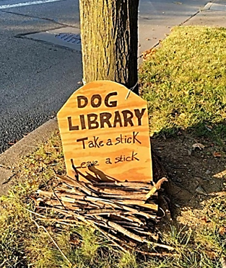
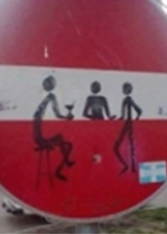
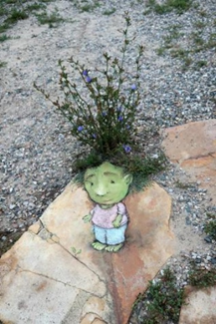

Slide 18
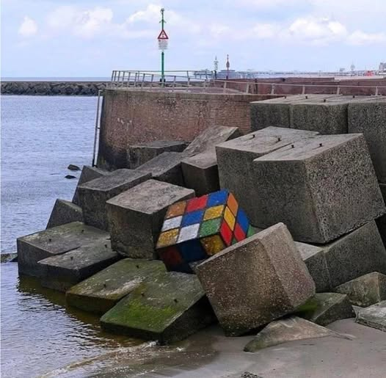
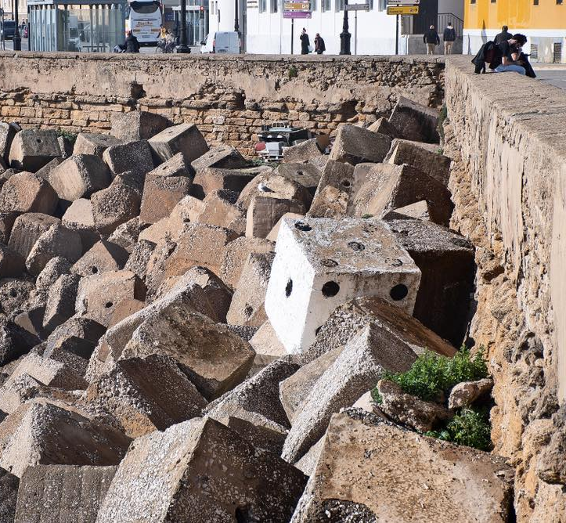

Slide 19
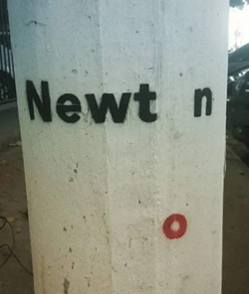

Slide 20
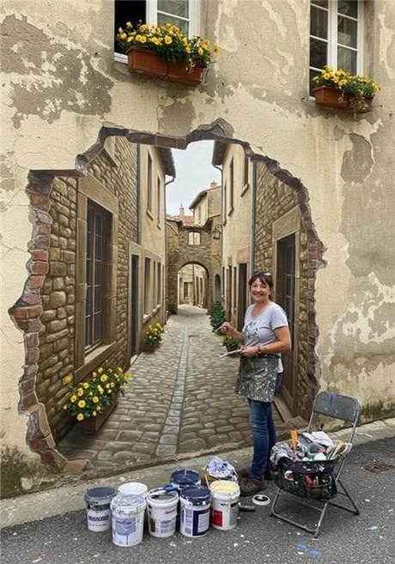
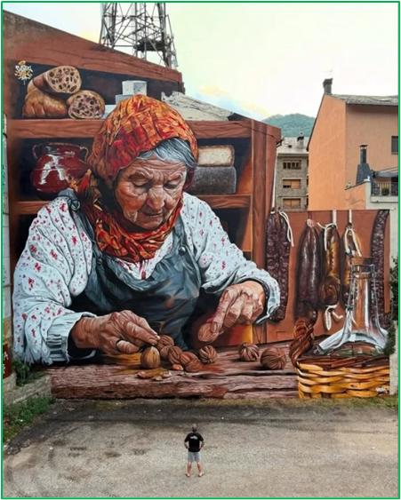

Slide 21
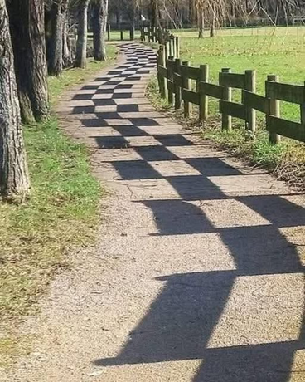
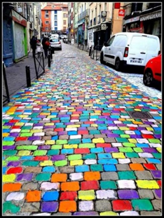
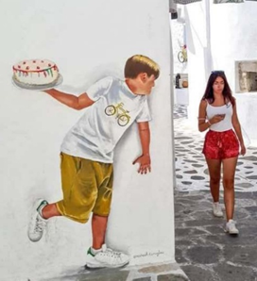

Slide 22
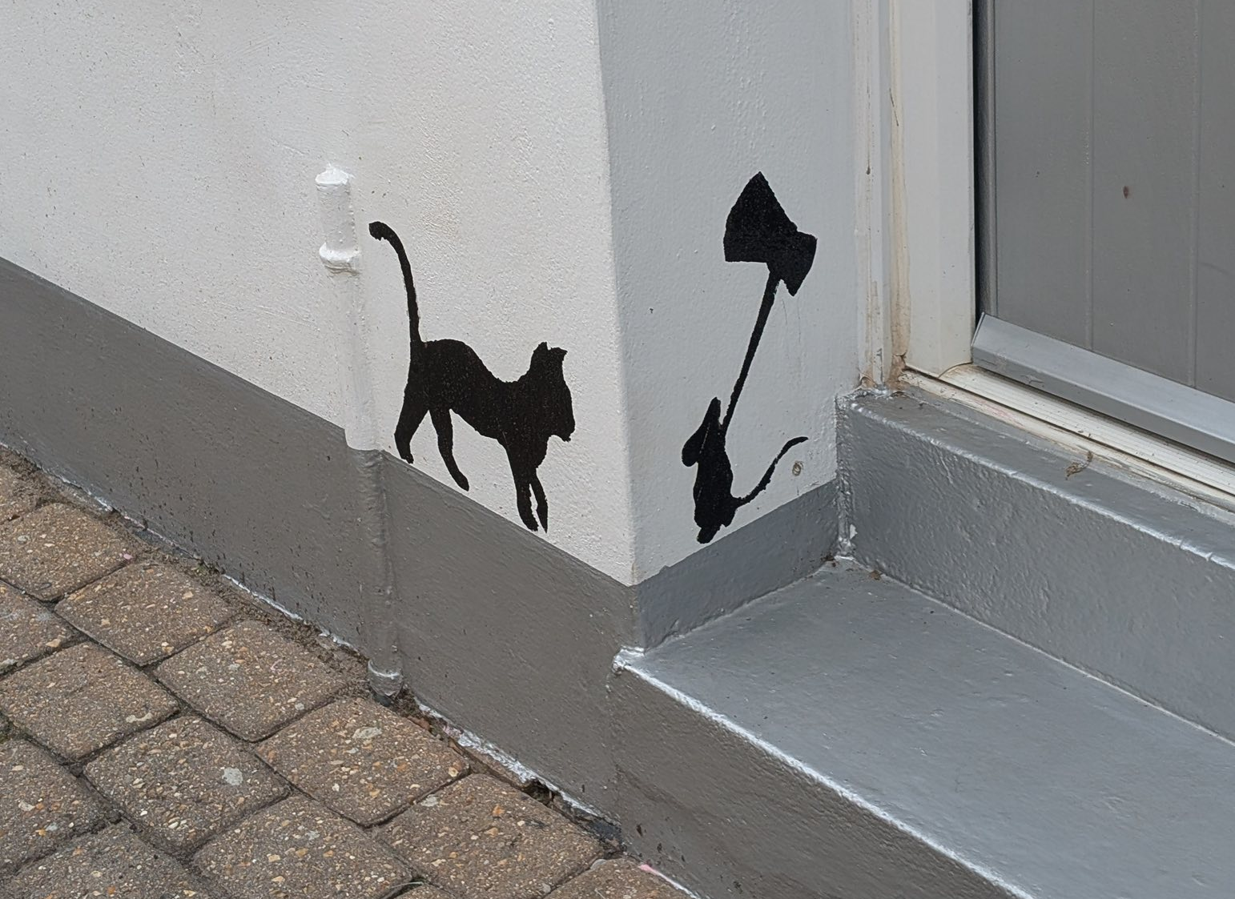

Slide 23
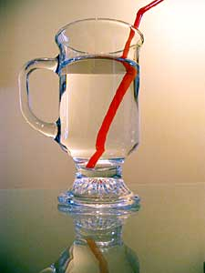

Slide 24
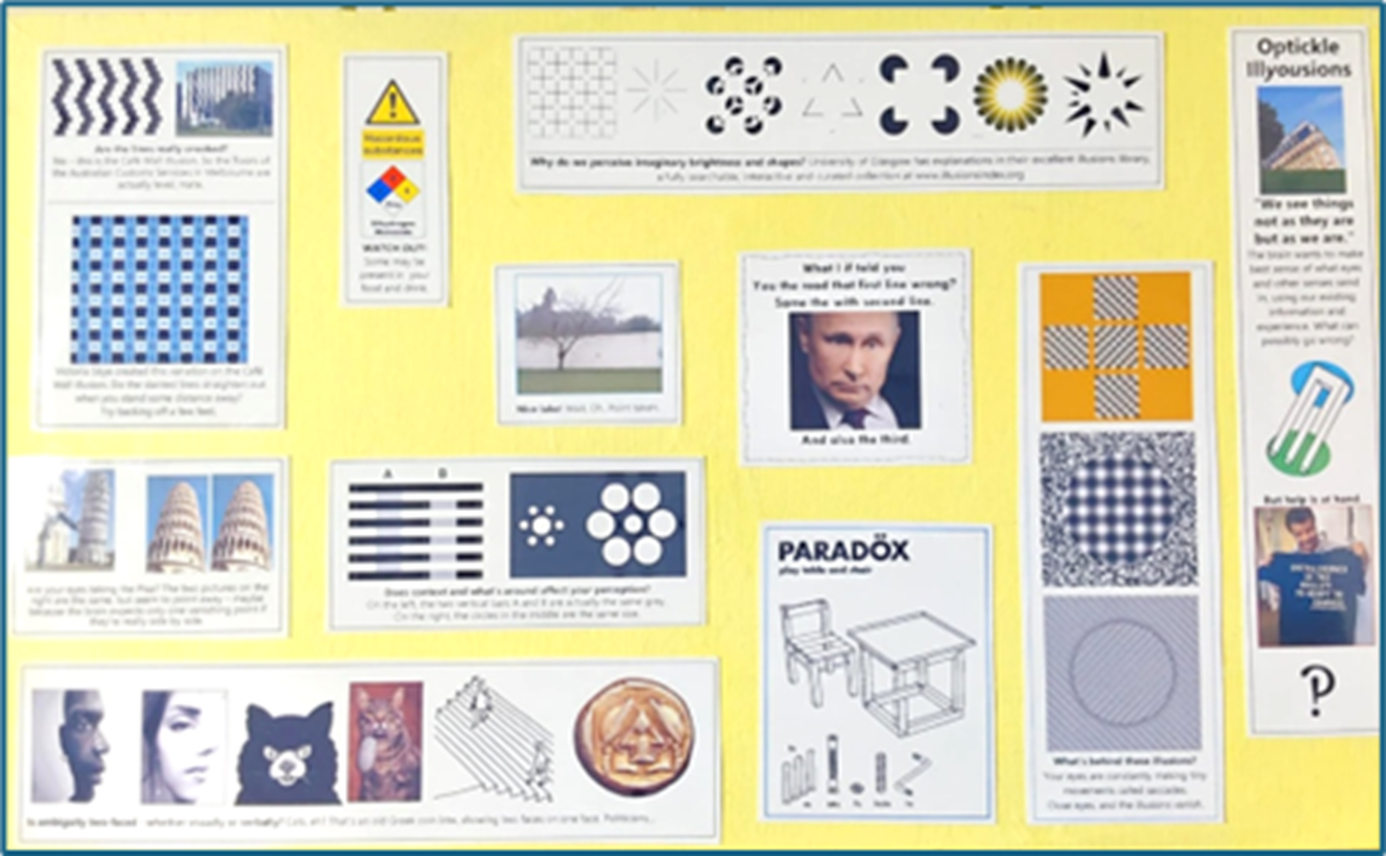
OPTICKLE ILLUSIONS
PANEL
Exploring
how we perceive things
not as they are
but as we are.
as your brain tries to
make sense of your eyes’ input

Slide 25
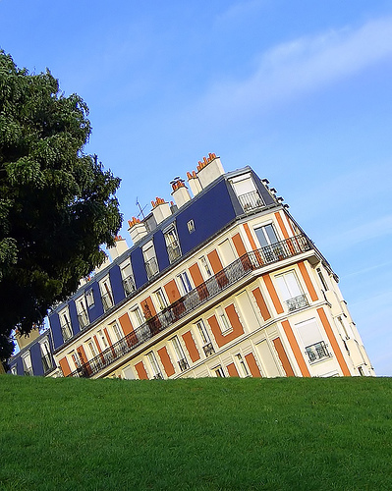
Brain says: green, level – so grass, usually horizontal.

Slide 26
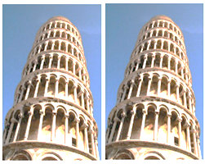
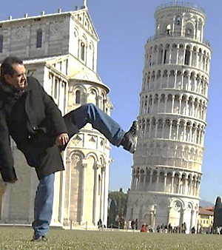
Same picture side by side. Brain says: if this was really similar towers side by side, then perspective would make them converge. But they don’t. So the right one must be tilted way off, obvs.

Slide 27
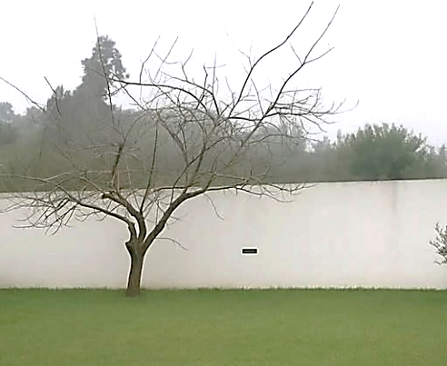
Nice lake!
Or?

Slide 28
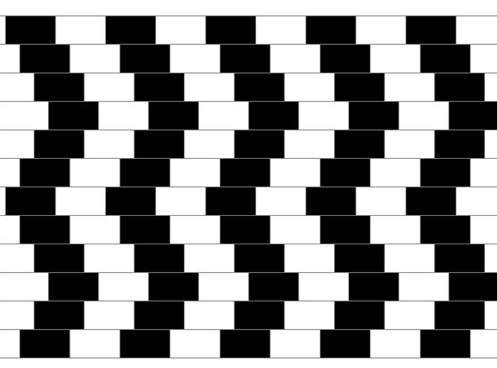
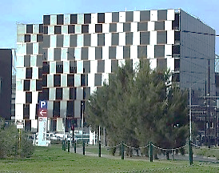
The well-known Cafe Illusion.
The horizontal lines are all actually level.
The idea’s wittily used in the Australian Customs HQ in Melbourne. The floors inside are all level!

Slide 29
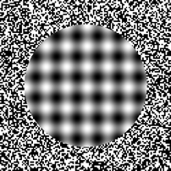

The pictures aren’t moving. But your eyes are – constantly, in small jumps called saccades

Slide 30
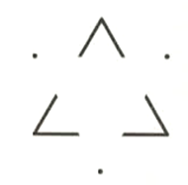




All the background here is the same white.
It’s your brain that decides they’re 3D shapes with extra brightness.

Slide 31
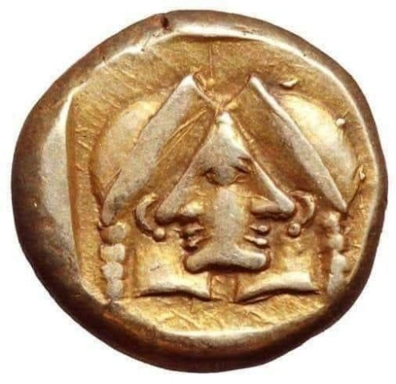
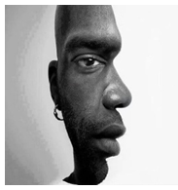
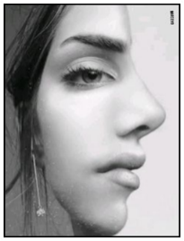
Ambiguity is at play here – two into one does go. You may sense your eyes moving ever so slightly to see the faces.

Slide 32
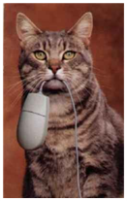
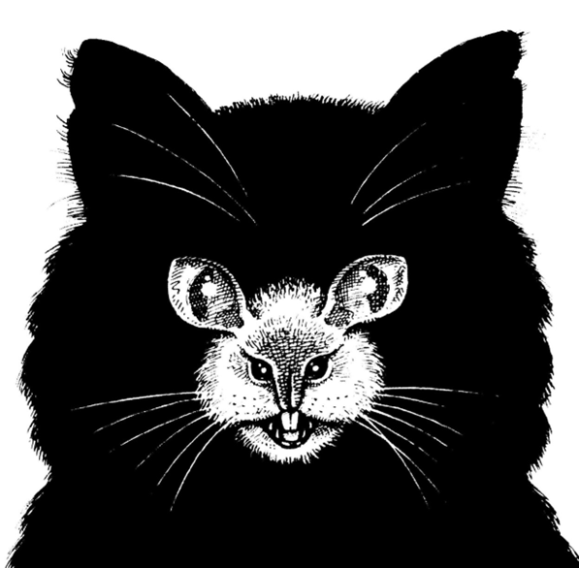
Purrfect ambiguity.

Slide 33
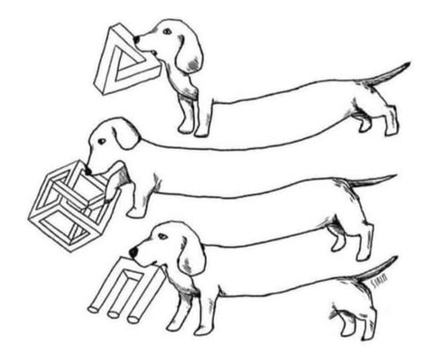
Dogs can be really impossible at times.

Slide 34

The Self-Assembly Illusion (well-known to Dads…)

Slide 35

Where might you encounter this hazardous substance?

Slide 36

The University of Glasgow has an excellent illusions library - a fully searchable,
interactive and curated collection with lots of explanations at
www.illusionsindex.org

Slide 37

What I if told you
You the read that first line wrong?
Same the with second line.
And also the third!

Slide 38


There’s evidence to suggest that ascending and descending elements play a role, too - that what we're recognising is the shape of a word. This is why mixed-case text, SUCH as alternating CAPITALS, is so Difficult to rEAd - it radically changes the sHAPe of a word, even when all the letters are in the right place.

Slide 39


Slide 40

CELEBRATING
SCULPTORS
PANEL
Exploring the value of public artwork in sharing stories, ideas, history and
humanity

Slide 41



SKYLARKS
in Peacock Meadows, Jennetts Park, Bracknell by Kerry Lemon
Kerry’s art is also seen throughout the Lexicon in Bracknell – and includes the Herbarium that hides an electricity substation near Waitrose!

Slide 42

SINGING RINGING TREE
A wind-powered sound sculpture resembling a tree, at Crown Point overlooking Burnley - designed by Mike Tonkin and Anna Liu.

Slide 43

THE KELPIES are the world’s largest equine sculptures
by artist Andy Scott at the Helix Park in Falkirk, Scotland

Slide 44


KINDRED SPIRITS
by Alex Pentek in Midleton near Cork in Ireland commemorates the 1847 donation by the Choctaw Native American people to Irish famine relief during the Great Famine - despite the Choctaw themselves living in hardship and poverty and having experienced their own Trail of Tears.
The 20ft high stainless steel eagles’ feathers represent an empty food bowl.

Slide 45


LA CARGA (THE BURDEN)
By Jaume Plensa in Barcelona symbolises the weight of domestic duties so often borne by women.
THE WEIGHT OF GRIEF
by American sculptor and artist Celeste Roberge

Slide 46

STRICTLY COME RAILING
Location unknown
‘THE PEEKERS OF CONQUES’
By an unknown mason at the Abbey of Sainte Foy in France

Slide 47


SIR NICHOLAS WINTON
A statue by sculptor Flor Kent is on Platform 1 at the main railway station in Prague – where Kindertransports left for UK in 1939. Another by his neighbour Lydia Karpinski is on Platform 3 at Maidenhead Station

Slide 48



THE JURORS Commissioned by the National Trust, these 12 intricately worked bronze chairs by Hew Locke at Runnymede mark 800 years since the signing of Magna Carta. The fronts and backs are rich in stories and examples from round the world – and history.

Slide 49



THE TRAVELLERS also known as Les Voyageurs are the dozens of remarkable bronze sculptures that represent migrants by Bruno Catalano.
Each carries a suitcase.
HANDS IN WATER was created by Lorenzo Quinn for the 2017 Venice Bienalle - to warn of rising sea levels with climate change.

Slide 50



“I have created nothing really beautiful, really lasting.
But if I can inspire one of these youngsters to develop the talent I know they possess, then my monument will be in their work.”
Augusta Savage was a sculptor at the heart of the Harlem Renaissance, an American cultural, social, and artistic movement. She was also a teacher whose studio was important to the careers of a generation of artists who would become nationally known. She worked for equal rights for African Americans in the arts. Her famous work known as The Harp is actually named Lift Every Voice and Sing!

Slide 51


Slide 52

LET’S HEAR IT FOR SILENCE
PANEL
Appreciating the soundtrack of everyday life
around you

Slide 53



Noticed in Private Eye Magazine September 2025

Slide 54


Slide 55


4’ 33” (In Proportional Notation) by John Cage

Slide 56


UnCaging Ears
John Cage on the first performance of his composition 4’33” by pianist John Tudor
“You could hear the wind stirring outside during the first movement. During the second, raindrops began pattering the roof, and during the third people themselves made all kinds of interesting sounds as they talked or walked out.”
“There's no such thing as silence. What they thought was silence, because they didn't know how to listen, was full of accidental sounds.”

Slide 57
4’ 33” (In Proportional Notation) by John Cage
Why not try it out - with any instrument or players or audience or setting?

Slide 58


Slide 59



Slide 60


Slide 61

THE CASE FOR
CURIOSITY
PANEL
Exploring the value of uncertainty

Slide 62


Slide 63

“But maybe our ideas are completely off. Maybe asteroid Psyche is made of some other substance that is both spectrally featureless and yet less dense than metal.
“Sometimes we can get stuck on preconceptions, ideas that are welded together by chance. Sometimes we can’t just open our minds to see new possibilities.”
Br Guy Consolmagno SJ Director of the Vatican Observatory: in Missions Accomplished More or Less, in The Tablet June 2025.
He’s seen at Castelgandolfo greeting Pope Leo X!V, who popped round from his quarters to meet astronomy students. The Vatican Observatory was founded in 1774.

Slide 64



Slide 65

I think it's much more interesting to live not knowing than to have answers which might be wrong.
I have approximate answers, and possible beliefs, and different degrees of uncertainty about different things, but I am not absolutely sure of anything.
There are many things I don't know anything about, such as whether it means anything to ask "Why are we here?" I might think about it a little bit, and if I can't figure it out then I go on to something else.
But I don't have to know an answer. I don't feel frightened by not knowing things, by being lost in the mysterious universe without having any purpose - which is the way it really is, as far as I can tell.
Richard P. Feynman, theoretical physicist, drummer, and one of the most interesting writers you’ll ever come across

Slide 66


Slide 68


THE
DAZZLE MIRROR
PANEL
Seeing yourself as a living mosaic…

Slide 69


This mirror is made of acrylic shapes stuck to a background of dazzle designs created by Vorticism abstract artists during WW1 to make the speed and direction of ships at sea puzzling to attackers.
They’re the forerunners of many types of camouflage today.
As with all mirrors, only you get to see the dazzling images you create each time you have a look…

Slide 70
Assembled by
Hugh and Ug Gibbons!
Contact?
hughgibbons@just1.org.uk
Also at
www.just1.org.uk/interrobang

